Slide 1

Introduction to Quantum Encryption

Slide 2

Roadmap
What is a Polarizer?
How does a Polarizer work?
Quantum Encryption with Alice and Bob
Hands-on Quantum Encryption Activity

Slide 3
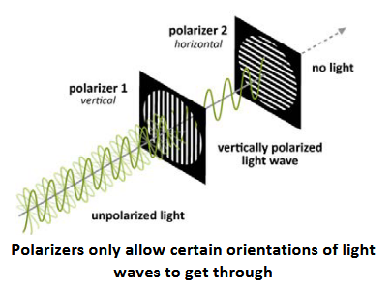
What is a Polarizer?
A single polarizer will filter out or block all incoming light waves except for the light wave that is perpendicular to the filter
A “crossed polarizer” is a stack of two polarizers on top of each other, where the second polarizer is rotated 90 degrees (perpendicular) – resulting in no light shining through

Slide 4

How do Polarizers work?
Most light sources, like light bulbs or the sun, produce light waves oriented in all directions (randomly polarized light)
A polarizer blocks certain orientations of light
Once light goes through, it is plane polarized, meaning that all of the light waves are now parallel to each other
When looking through two (or more) polarizer films, the brightness depends on how the polarizer films are aligned
When you rotate the polarizer films, the brightness changes
When you have two polarizers that are oriented parallel to each other, all light will make it through
When you have two polarizers that are oriented perpendicular to each other, no light will make it through

Slide 5
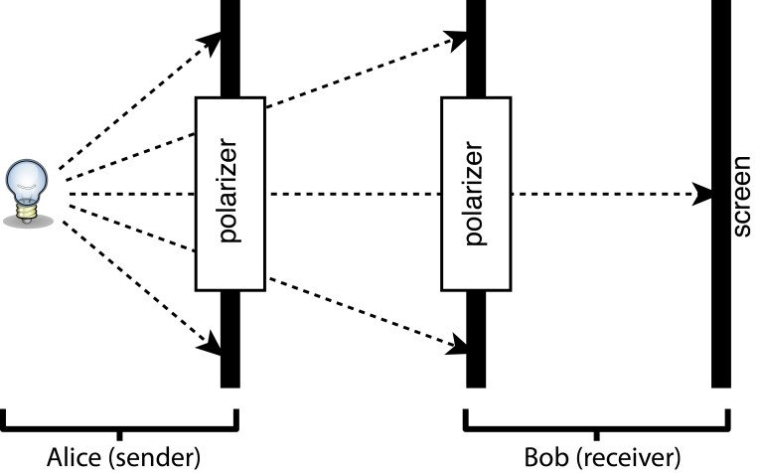
Alice and Bob Hypothetical
Let’s say that Bob is sitting in front of Alice, and Alice (for some reason) wants to send a binary string to Bob using their polarizers
Bob will keep his polarizer oriented in the horizontal position while Alice will rotate her polarizer between the horizontal and vertical positions depending on whether she wants to send a “0” or “1”
Using a light source behind Alice and screen in front of Bob, Alice can send messages to Bob:
If Alice’s polarizer is horizontal, then her polarizer will be parallel to Bob’s polarizer – allowing all light to pass through (relating to “0”)
If Alice’s polarizer is vertical, then her polarizer will be perpendicular to Bob’s polarizer – allowing no light to pass through (relating to “1”)

Slide 6

Alice and Bob Hypothetical (cont.)
For example, let’s say Alice wanted to send “0110” to Bob:
1. Alice will rotate her polarizer to the vertical position, all light shines through, Bob marks “0”
2. Alice will rotate her polarizer to the horizontal position, no light shines through, Bob marks “1”
3. Alice will rotate her polarizer to the horizontal position, no light shines through, Bob marks “1”
4. Alice will rotate her polarizer to the vertical position, all light shines through, Bob marks “0”

Slide 7
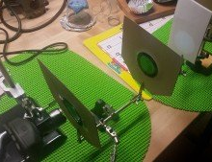
Hands-On Basic Quantum Encryption
Now it’s your turn to do the same thing!
With those around you, perform the “Alice and Bob” Communication Example
Align the flashlight, polarizers, and index card in the alligator clip holders so that you can properly see a bright circle on the index card
See if you can encode/decode 4-bit binary strings between you and your partner(s)!

Slide 8
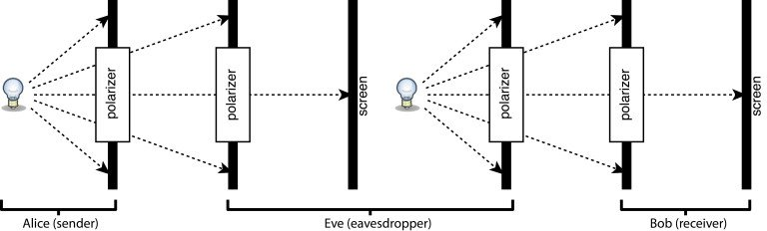
Bad Actor during Communication
An eavesdropper, Eve, could intercept the beam during communication
She plants herself in between Alice and Bob
She follows the same procedure to record a bit as Bob - keeps the polarizer in the same orientation and record whether she sees no light (“1”) or all light (“0”)
She then can retransmit that same message to Bob using her polarizer and flashlight
Alice and Bob would never know that Eve successfully interfered in their communication

